Slide 1
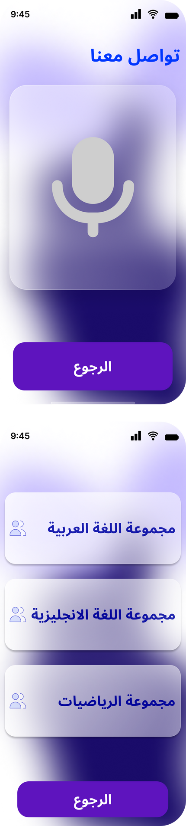
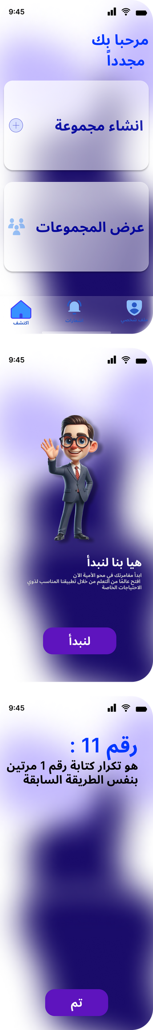



El-Serag
Literacy platform for special needs
Superviesed By:
Dr. Hussein Elshafie
Dr. Amany Ashraf

Slide 2

Team Members
Mohamed Abelrahman Elkhlawy
Manar Hussien Mohamed
Amina Younis Mohamed
Omar Mohamed Elhassan Madany
Norhan Nageh Elabd
Sara Nabil Mohamed Kamel

Slide 3
Table Of content
1) Problem Formulation
2) Target Beneficiary
3) Related Work
4) Proposed Solution
5) Domin Analysis :
Context Diagram
Main and Feature Use case
6) Financial Benefit
7) Presenting and implementation(app)

Slide 4


Problem Formulation
In a world where information is a cornerstone of empowerment and progress, there exists a profound issue that warrants immediate attention. Individuals with special needs, including those with physical disabilities, cognitive impairments, or sensory challenges, often face significant barriers when it comes to accessing and benefiting from traditional literacy education
Existing educational materials and platforms are not always designed to cater to the diverse needs of this population. This lack of inclusivity and accessibility can limit their opportunities for personal growth, communication, and participation in society

Slide 5


Target Beneficiary Group
Blind People : no sighted people
Visually impaired people :Limited sight, heightened senses compensate.
Person with correct vision : Unimpaired vision, typical sensory experience.

Slide 6

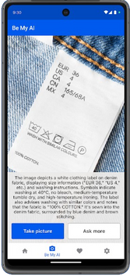
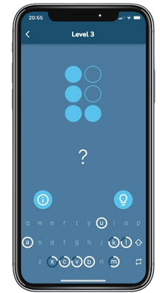
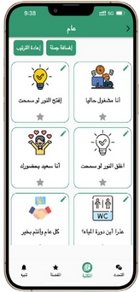

Related Works
Be My eyes
Braille Academy
Live video assistance
Support various tasks
Interactive braille lessons
Voice-guided instructions
Smart Voice
Brille One
Adjustable reading speed
Text-to-speech for different document types
Device used for typing brille
portable device
Tanglible Keyboard

Slide 7

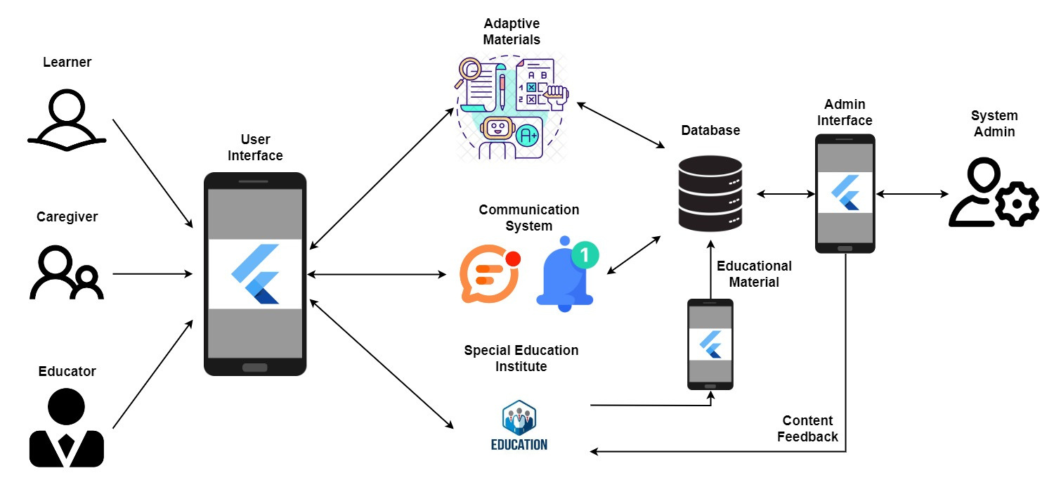

Proposed Solution
System Architecture

Slide 8


Domain Analysis

Slide 9
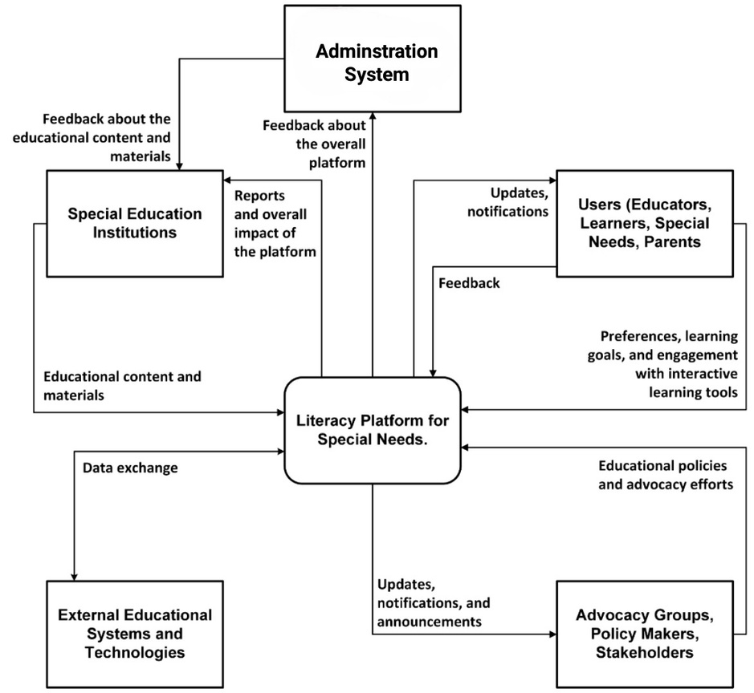
Context Diagram

Slide 10
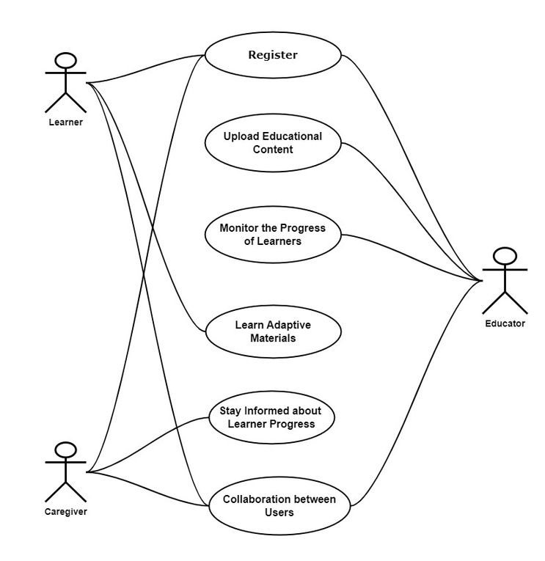
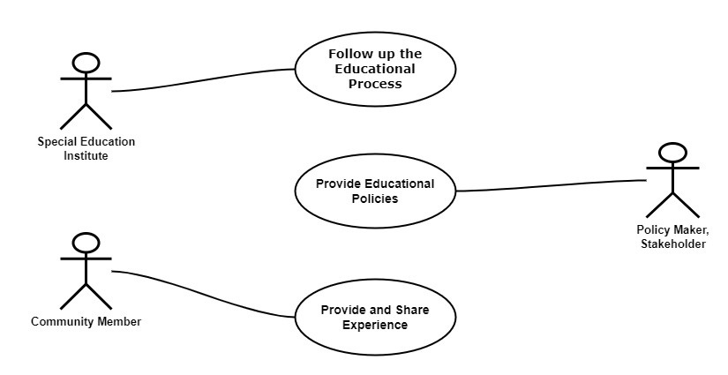
Main and Future Use case
Future Use case
Main Use case

Slide 11


Financial Benefit
UNESCO
UNESCO fosters inclusive education and cultural accessibility for individuals with disabilities, promoting their full participation in society
UNDP
The UNDP promotes inclusivity for people with disabilities, advocating for equal opportunities and accessibility worldwide.

Slide 12
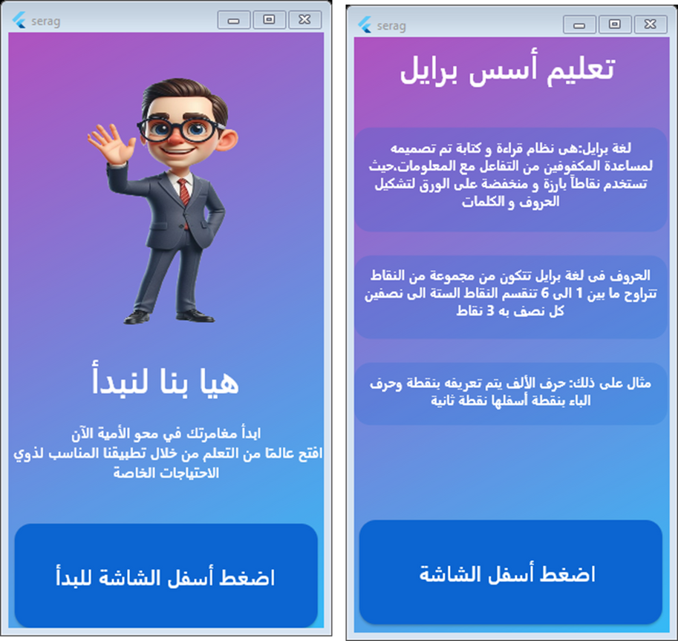
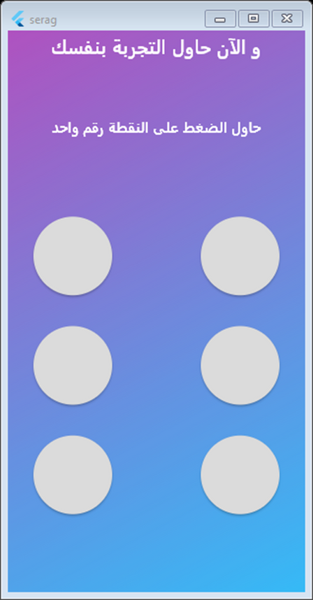
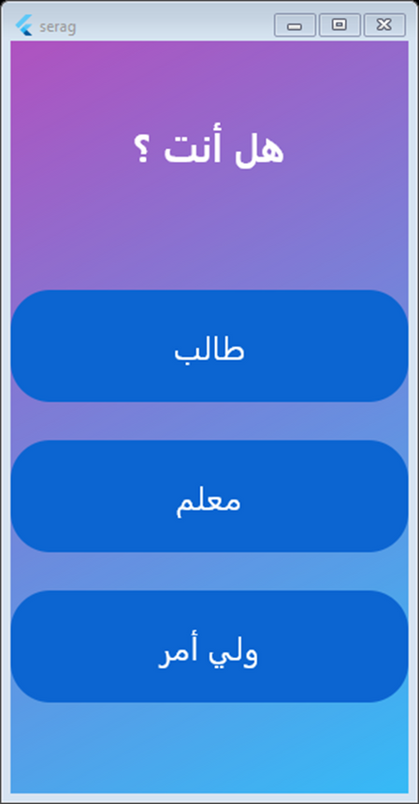
Presenting implementation
train interface

Slide 13
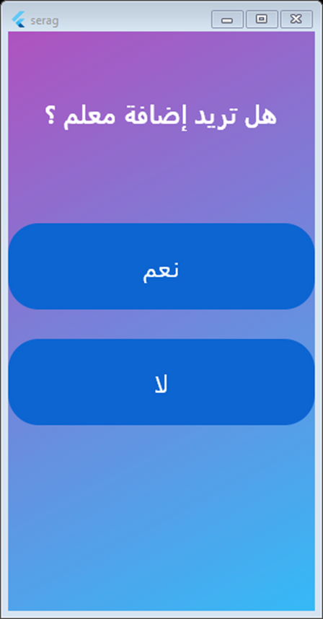
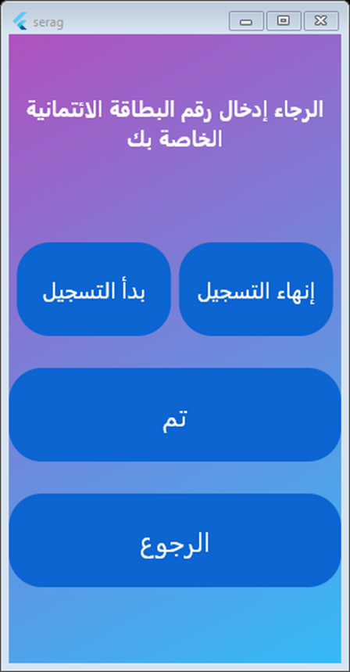
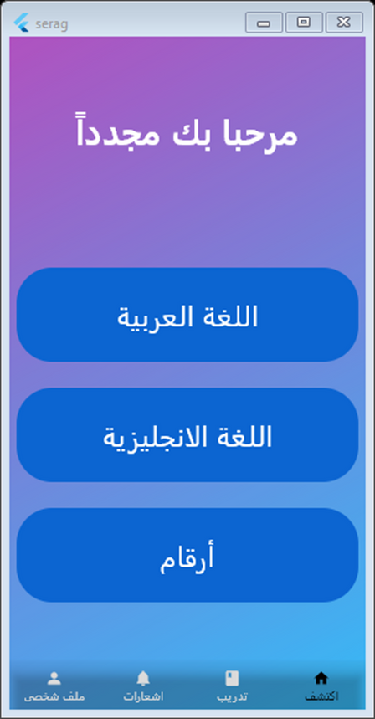
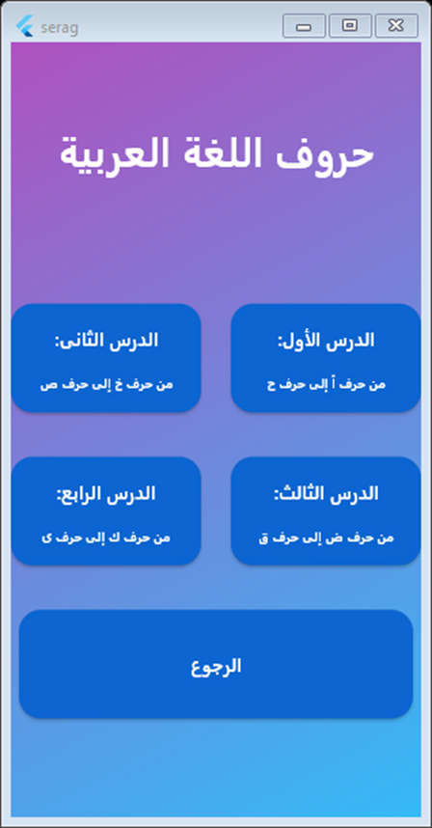
presenting implementation
Student Preview

Slide 14
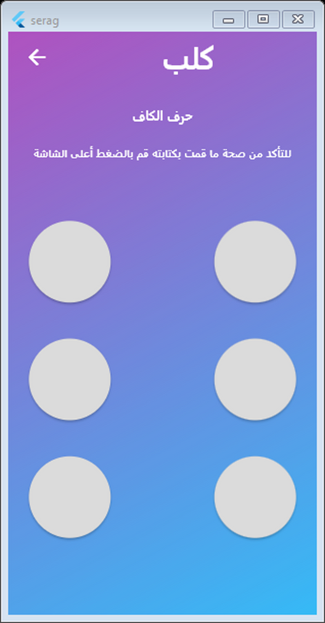
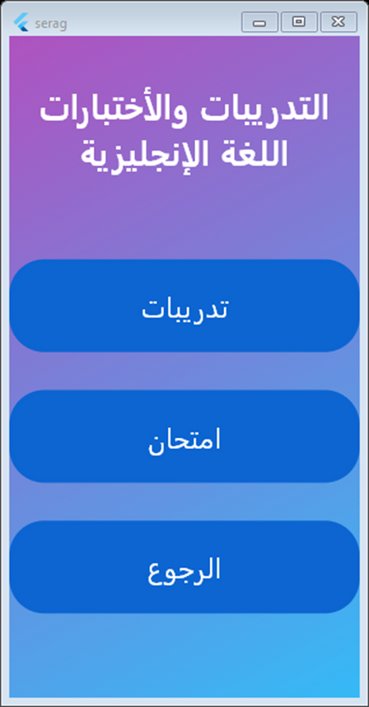
presenting implementation
Student preview 2

Slide 15
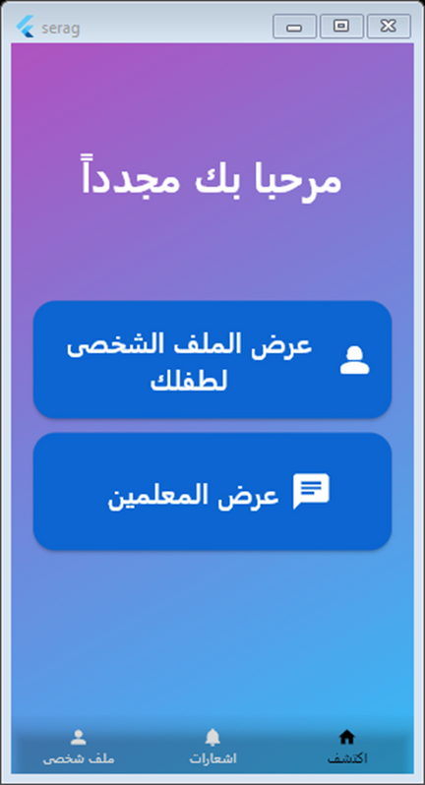
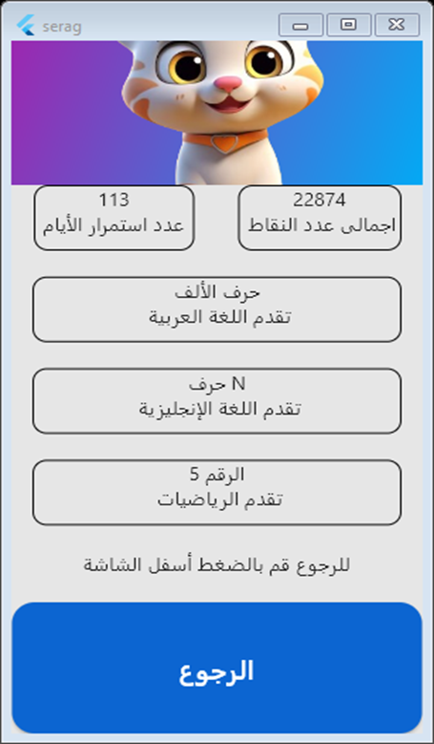
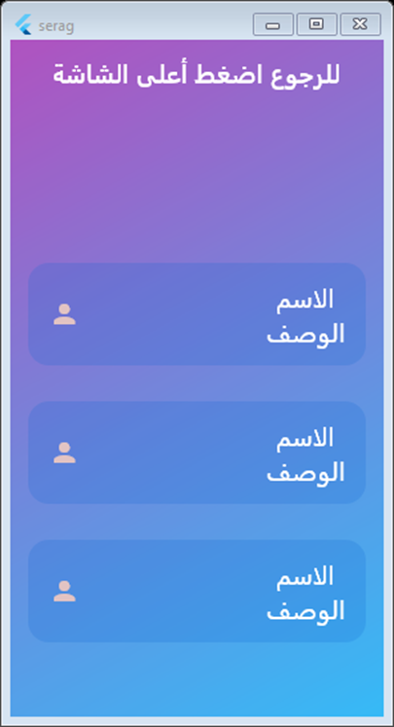
presenting implementation
CareGiver Preview

Slide 16
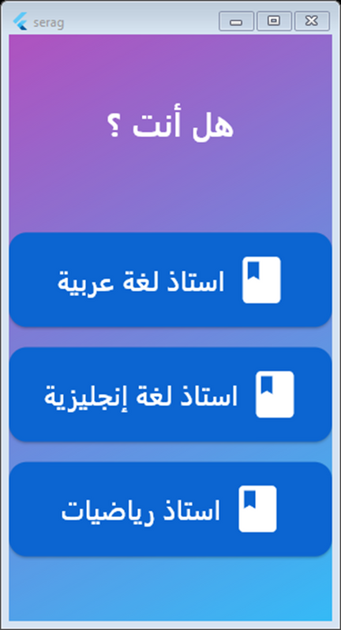
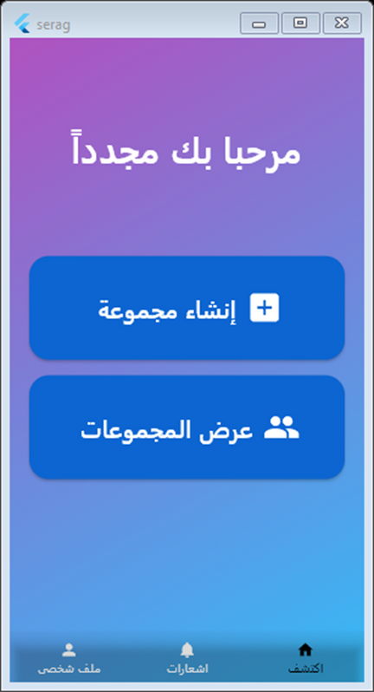
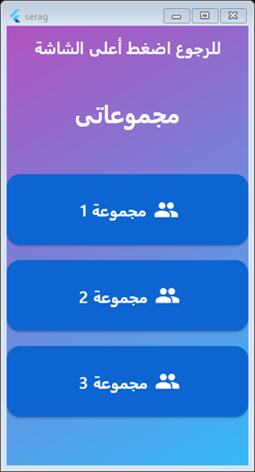
presenting implementation
Educator Preview

Slide 17
THank you for Listening

